Slide 1
Calculating Yield
5.20.24 version 1.0

Slide 2

Assumptions and Prerequisite Skills
Recommended 3 yield calculations per shift
Approximately every 3 hours or every 20 batches
The computer is on and Intellibatch 3.0 is open
Supplies Needed
Calculator (Recommended)
The calculator app on the computer is sufficient
Standard PPE Equipment
Data from the Daily Production Sheet

Slide 3
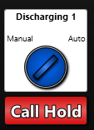
Procedure
1. Wait until the “Mud Hopper” weight is approximately 0 before starting calculations.
2. Click on the “Auto Call” button under the Discharging 1 switch (Figure 1). The button will then display as show in Figure 1.
Figure 1

Slide 4
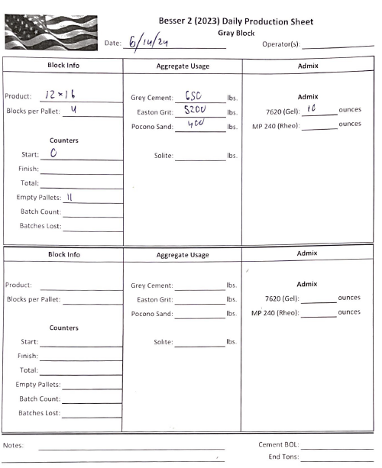
Procedure
3. Wait until the “Machine Belt” and “Mud Hopper” belt are empty. The machine will then pause and wait for more material.
4. Check if there have been any empty pallets throughout the day. To check, go to your Daily Production Sheet and find the number of empty pallets, if any (See red circle in Figure 2). The value of empty pallets will be noted in tally marks.
Figure 2. Indicates 2 empty pallets, not 11

Slide 5
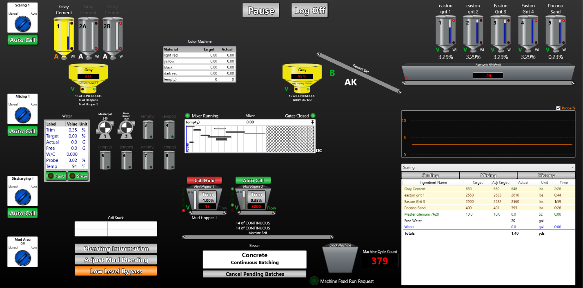
Procedure
5. Find the machine cycle count value on the main view page (See red circle in Figure 3). Then subtract the value you got in Step 4 from this value.
6. Take the machine cycle count value and divide it by the batch number (See yellow circle in Figure 3).
Figure 3

Slide 6
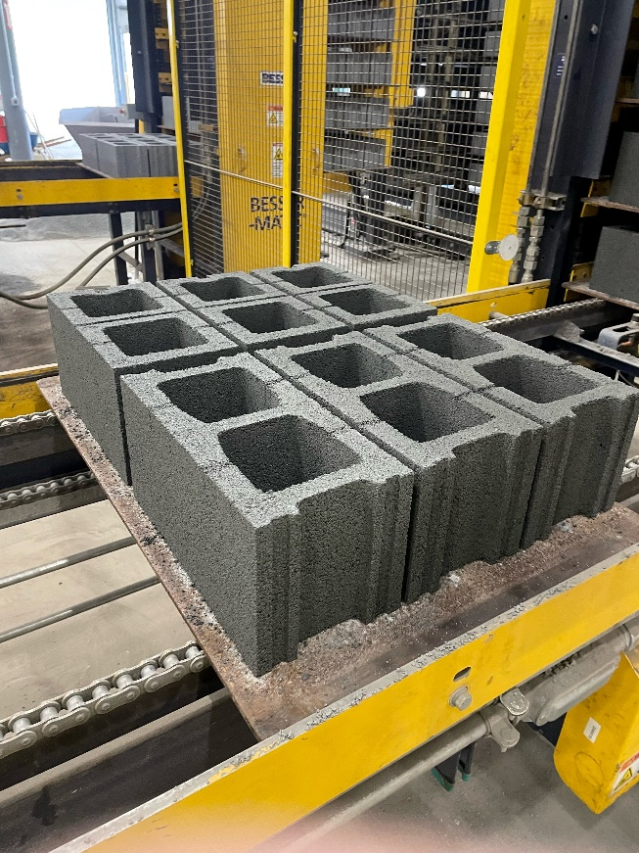
Procedure
7. At this point, you may click on the “Call Hold” button and put it back to its original status (Figure 4).
8. Multiply the result of Step 2 with the number of blocks per pallet. For example: an 8x8x16 cycle would have 6 blocks per pallet (Figure 5).
Figure 4
Figure 5

Slide 7
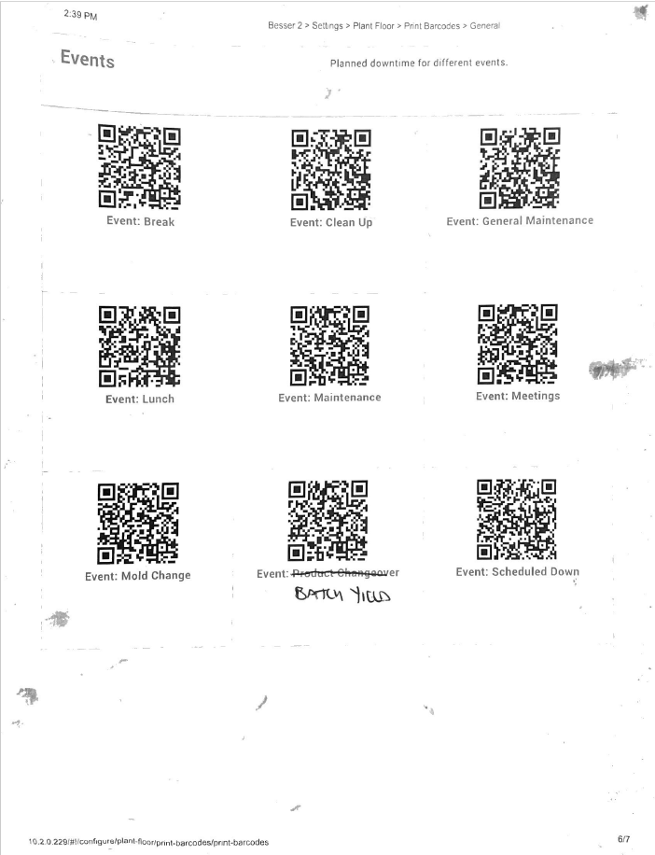
Procedure
9. Scan the “Yield” Event in the QR scan book for the Vorne and enter the yield value (Figure 6).
Figure 6

